Slide 1

RUNGTA COLLEGE OF DENTAL SCIENCES AND RESEARCH
COMPOSITES
(BASICS)
DEPARTMENT OF CONSERVATIVE DENTISTRY AND ENDODONTICS

Slide 2
Specific learning Objectives
LEARNING OBJECTIVES
Core areas* | Domain ** | Category #
Materials used | Cognitive | Nice to know
fillers | Cognitive | Must know
Physical properties of fillers | Cognitive | Must know
placement technique | psychomotor | Must know

Slide 3
CONTENT
  Materials used
  Filler sizes & its distribution
  shape
  Filler volume
  Radiopacity
  Hardness

Slide 4
MATERIALS USED:
  Pure silica
Crystalline
Non-crystalline
Crystobalite
Tridymite
quartz
Glass
Modifications by ions:
Li, Al
Ba, Zn, Y, St, Zr, B
Disadvantages
Egs

Slide 5
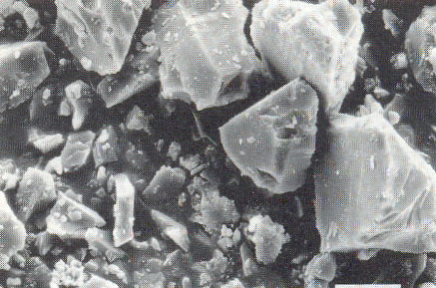
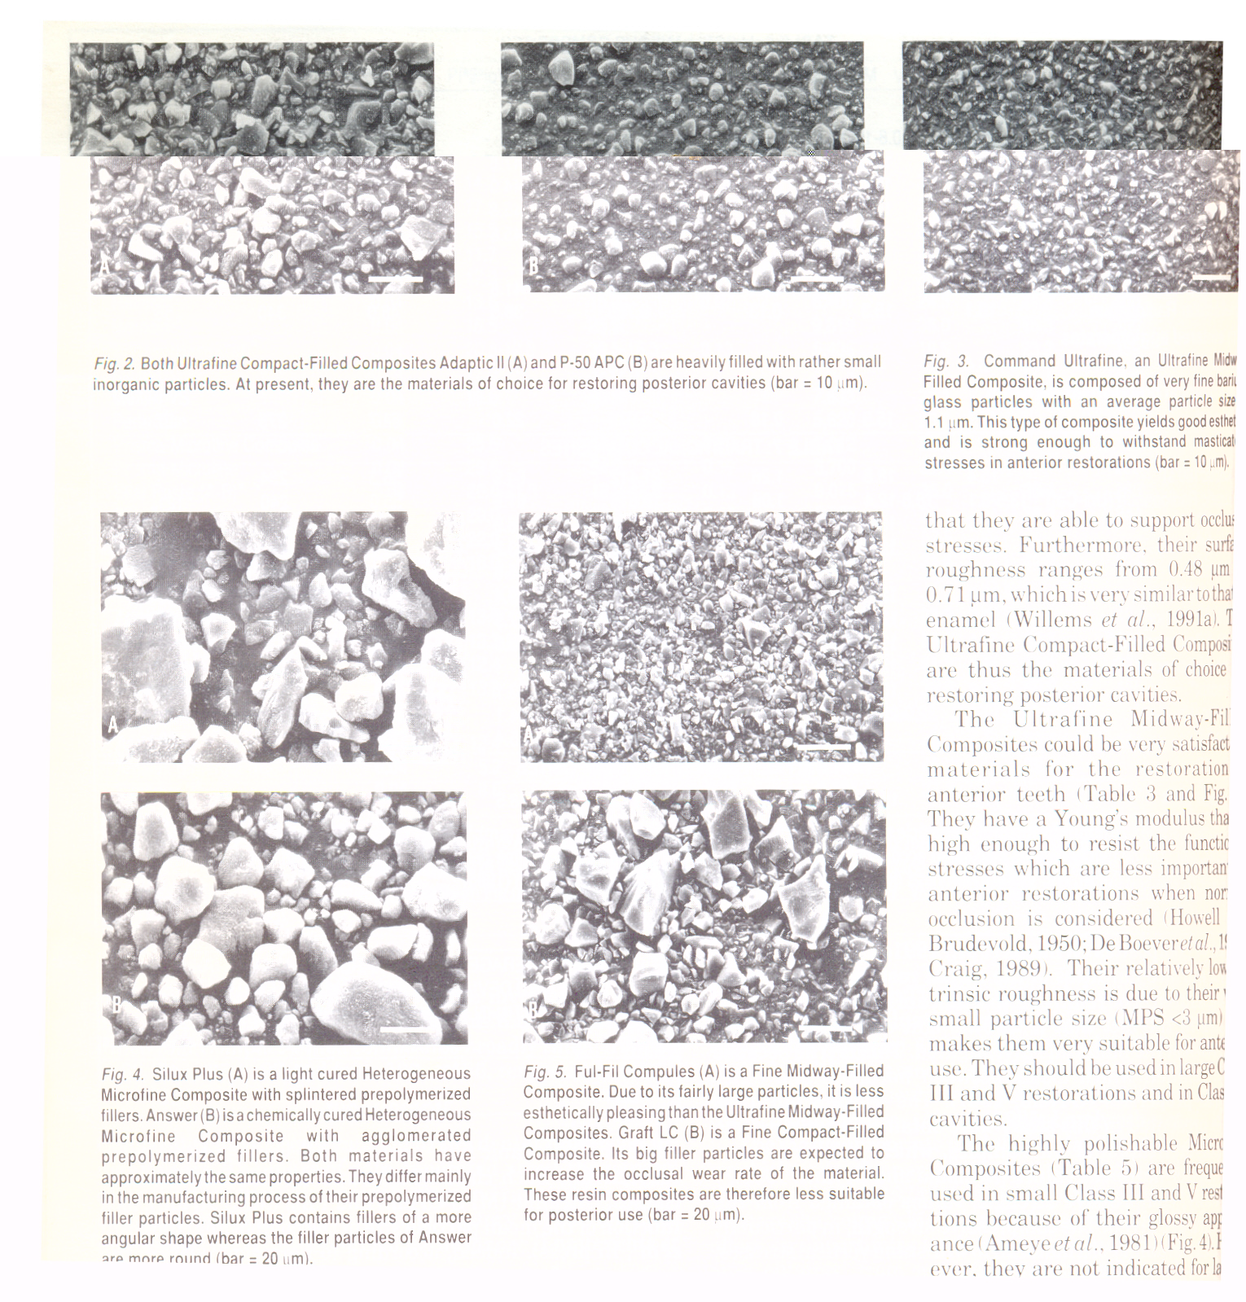
GROUND QUARTZ FILLER

Slide 6
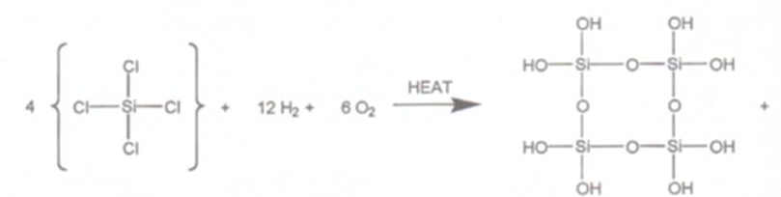
  Amorphous silica
    Colloidal silica
    Pyrolytic/precipitation process-Pyrogenic/fumed silica
    Agglomerated silica-1-25 μm

Slide 7
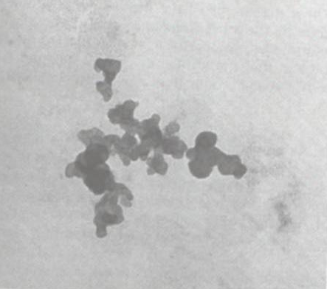
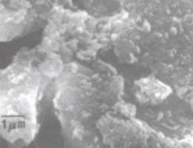
PYROGENIC SILICA

Slide 8
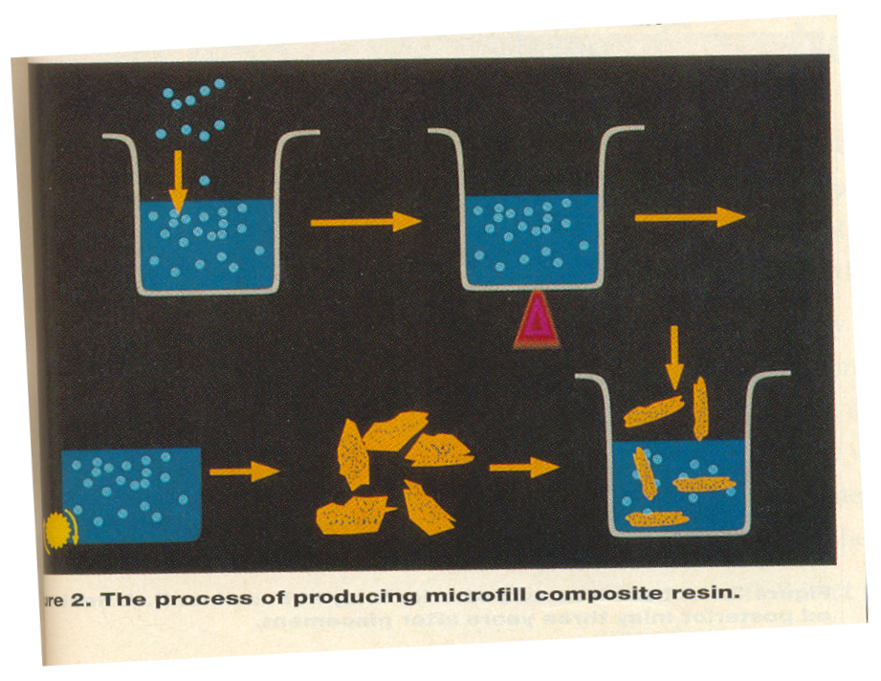
  Organic fillers
  Fibre fillers
  Single crystals-SiC
  Crystalline polymers

Slide 9
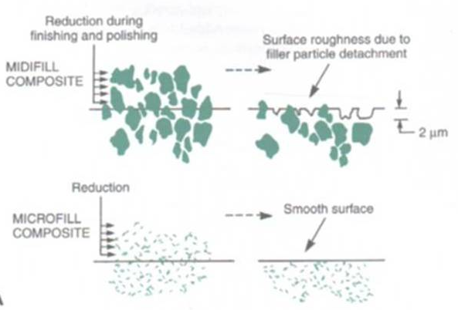
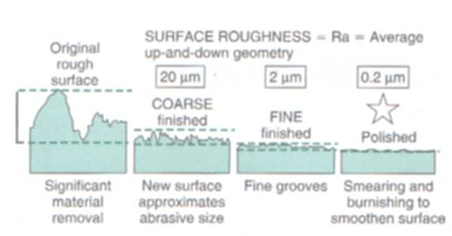
FILLER SIZES
  Mega, macro, midi, mini, micro, nano
  Marzouk:
    Macro-ceramics
    Colloidal & micro-ceramics
    Fabricated macro-reinforcing phases & colloidal micro-ceramic
  Properties-fluidity
  -surface roughness-
  0.2-0.6 μm

Slide 10
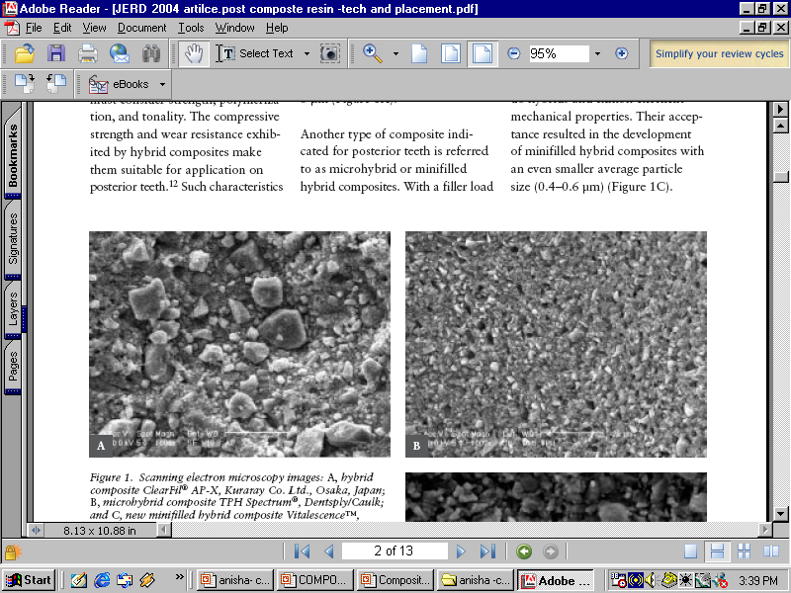
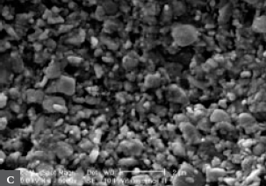
FILLER DISTRIBUTION (Lopes et al, J Esthet & Restor Dent 2004)
  Hybrids- 0.04-3 μm (Avg 1-3 μm),
  -7-15% microfillers
  Microhybrids – Avg 0.8-1 μm
  - polishable, mech properties, uniform filler load
  Minifilled Hybrids- Avg 0.4-0.6 μm
  - easy to light cure, polishability
  CONTINUUM-FILLED MATERIAL-66% synthetic Zr/Si
  - 0.01-3.5 μm (0.6μm)
Hybrid:
ClearFil
Microhybrid:
TPH Spectrum
Minifilled hybrid:
Vitalescence

Slide 11
FILLER SHAPES
  Large spherical particles
  Large irregularly shaped particles
  Blends
Refractive index

Slide 12
Placement techniques
(Deliperi & Bardwell, JADA,Oct 2002)
PLACEMENT TECHNIQUES
INCREMENTAL
TECHNIQUES
DIRECTED SHRINKAGE
TECHNIQUE
BULK TECNIQUE
Horizontal technique
Three-site technique
Oblique technique
Successive cusp build-up technique
Modified successive cusp build-up
Split incremental technique

Slide 13
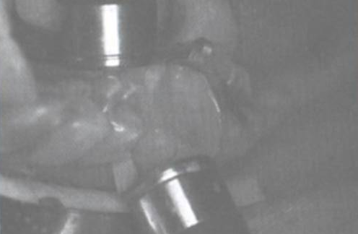
TRANS-ENAMEL POLYMERIZATION (Belvedere, DCNA, Jan 2001)

Slide 14
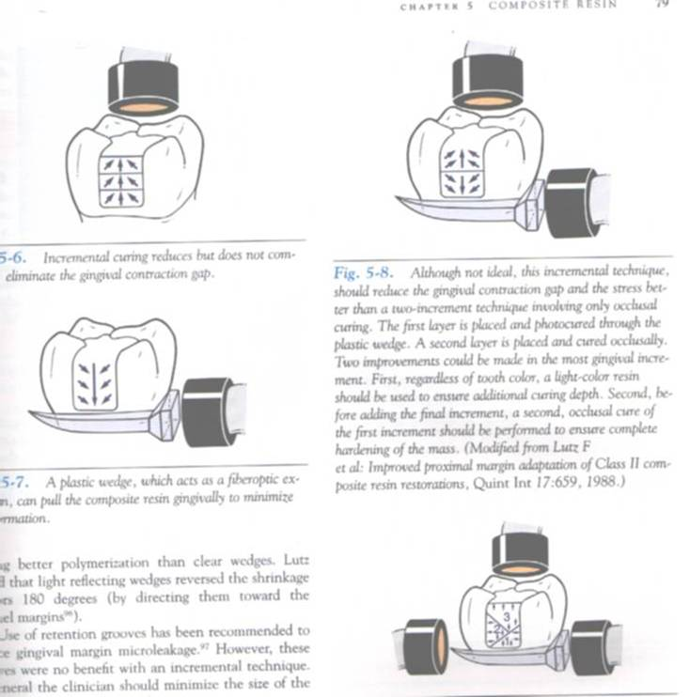
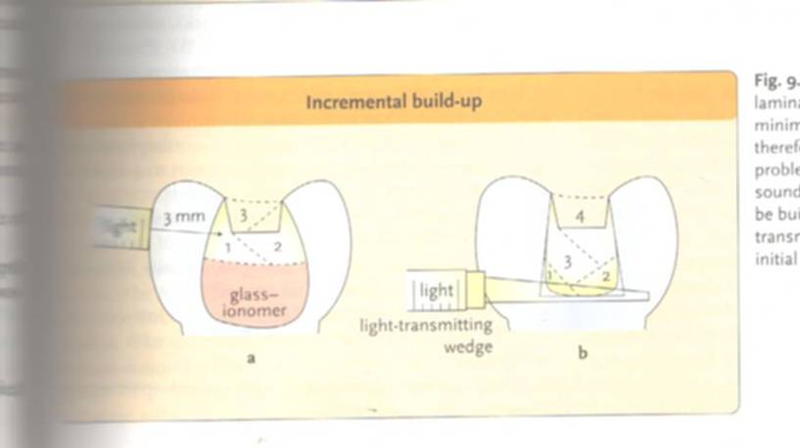
THREE-SITE TECHNIQUE

Slide 15
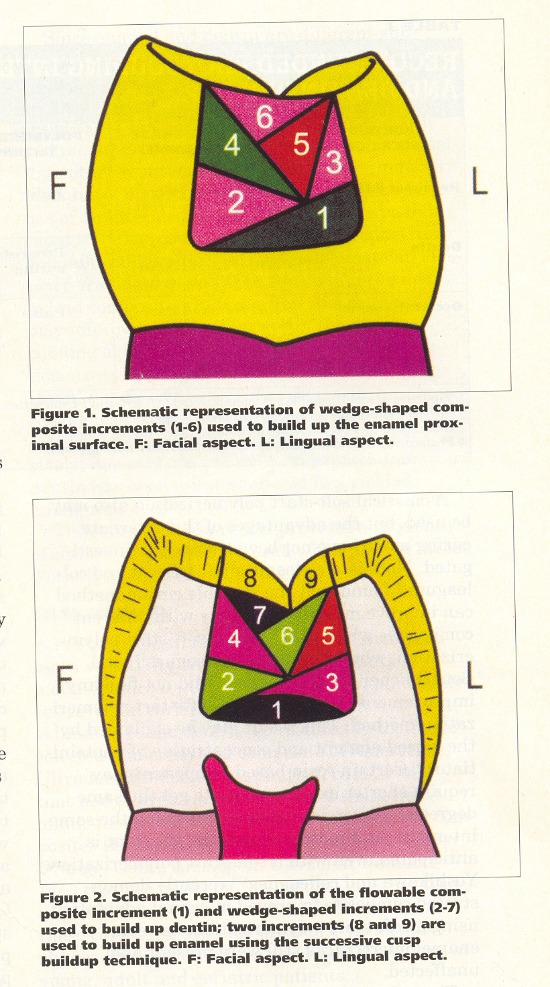
OBLIQUE TECHNIQUE

Slide 16
SUCCESSIVE CUSP BUILD-UP TECHNIQUE (Leibenberg, 1996)

Slide 17
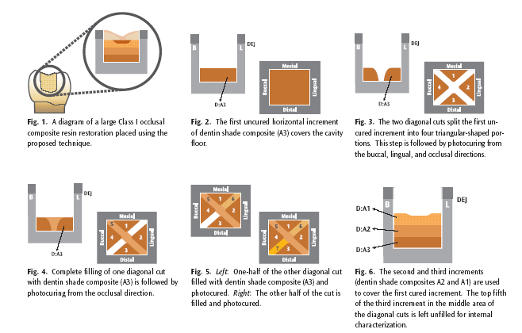
SPLIT INCREMENTAL TECHNIQUE
(Hassan & Khier, General dentistry, Nov-Dec 2005)

Slide 18
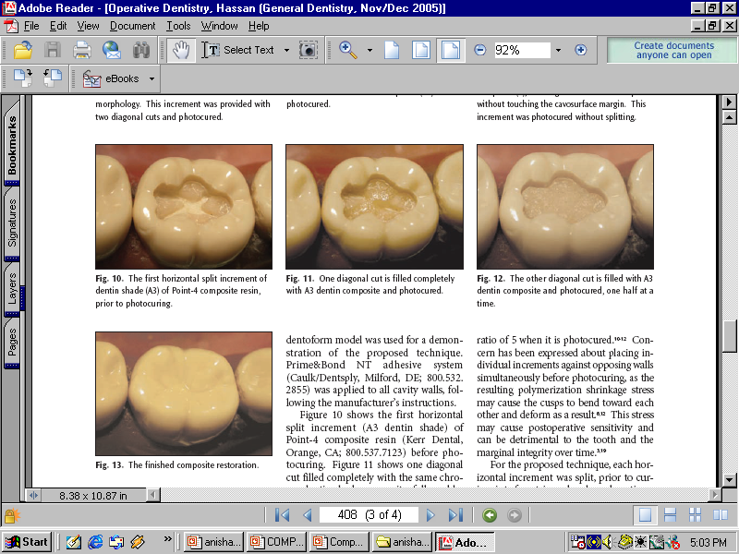

Slide 19
PROPERTIES…
PROPERTIES
PHYSICAL
MECHANICAL
CLINICAL
Working, setting time
Polymerization
shrinkage
Thermal properties
Water sorption
Solubility
Colour stability
Flexural strength
Compressive strength
Knoop hardness
Bond strength
Rigidity
Fracture toughness
creep
Wear
Depth of cure
Radiopacity
Biocompatibility
Staining
Secondary caries
Marginal integrity
Post-op sensitivity

Slide 20
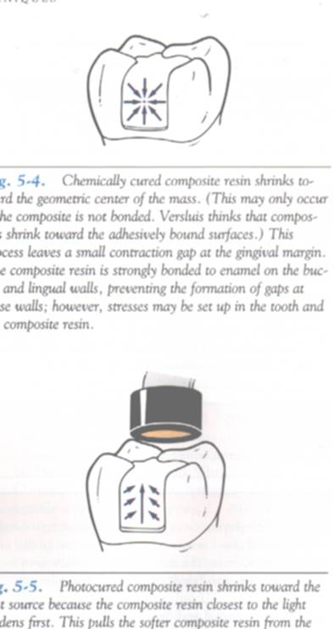
Physical properties
WORKING & SETTING TIME
  Light cure: surface hardens in 60-90 sec
  Chemical cure: 3-5 min
POLYMERIZATION SHRINKAGE
  Light cure: 60% in 60 sec
    Debonding, cusp fracture
    Macrofilled:1-2.5%
    Microfilled:2-3.5%
    Microhybrid:0.6-1.4%
  Chemical cure: even, towards centre

Slide 21
THERMAL PROPERTIES
  Places additional strain on bond-percolation
  Values for tooth, amalgam, unfilled resins, composites
COLOUR STABILITY
  Stains
  Change of colour
    Stress cracks
    Debonding of filler
    Oxidation
    Water sorption
WATER SORPTION & SOLUBILITY
  Macrofilled: 0.-1.1 mg/cm²
  Microfilled: 1.5-2 mg/cm²
  Solubility: 0.01-0.06 mg/cm²
  Benefits
  Colour instability, leaching, less wear resistance

Slide 22
Mechanical properties
FLEXURAL STRENGTH & MODULUS
  50% less for microfilled, flowable composites
  Thus used in cervical lesions
COMPRESSIVE STRENGTH
  Similar for all (240-290 MPa)
  Transverse strength-45-125 MPa
KNOOP HARDNESS
  Hybrid: 35-65 KHN
  Microfilled: 18-30 KHN
BOND STRENGTH
  For enamel, dentin
  For other substrates

Slide 23
RIGIDITY
  Microfilled: 4-8 GPa
  Hybrid: 8-19 GPa (similar to dentin)
  Large MOD restorations
CREEP
  Microfilled: creep
FRACTURE TOUGHNESS
  Resistance to crack growth
  Microfilled: 0.7-1.2 MNm^{-1.5}
  Hybrid: 1.4 – 2 MNm^{-1.5}
  Decreases with time

Slide 24
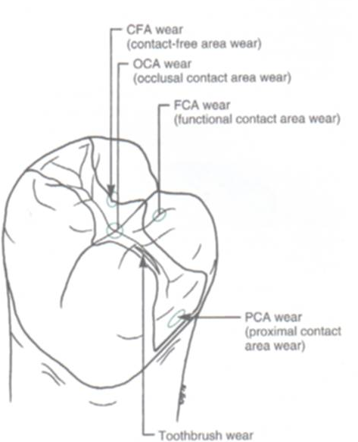
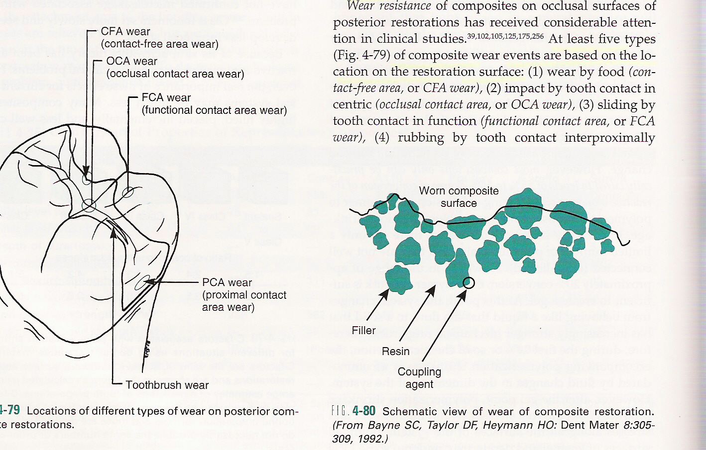
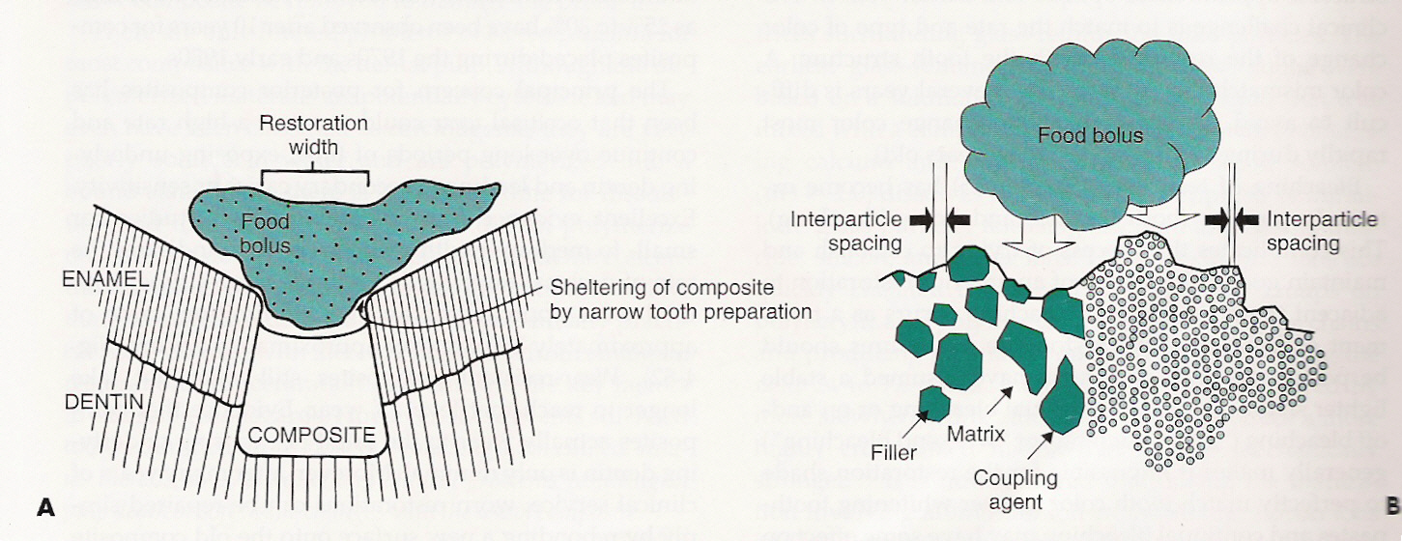
Clinical properties
WEAR
  Types-CFA, OCA, FCA, PCA, toothbrush, fatigue
  4 mechanisms
    Microfracture theory
    Hydrolysis
    Chemical degradation
    Protection
  Macro & microprotection
  Wear of opposing enamel

Slide 25
DEPTH OF CURE
  Increasing depth
  Increased time
  Heavily filled
  Microfilled & hybrid
  Light & translucent shade
  Efficiency of light
  Distance of tip
  Through tooth
  Conc of photoinitiator
  “step” the light for large restorations
  Large tip-more time-60 sec

Slide 26
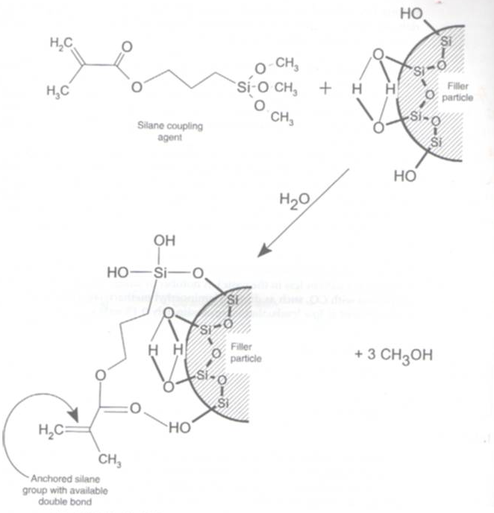
Coupling agents…
TYPES
  Organosilanes
  (γ-methacryloxypropyl trimethoxy silane)
  Titanates
  Zirconates
FUNCTIONS

Slide 27
Activator-initiator system…
CHEMICALLY ACTIVATED
  Benzoyl peroxide initiator (universal paste)
  Aromatic tertiary amine activator (N,N, dimethyl-p-toluidine)(catalyst paste)
LIGHT ACTIVATED
  Camphoroquinone -0.2%-1%
  Organic aliphatic amine –dimetylaminoethyl methacrylate (DMAEMA)-0.15%
  Blue light

Slide 28
Inhibitors, optical modifiers…
INHIBITORS
  Butylated hydroxytoluene (BTH)-0.01%
  Functions
OPTICAL MODIFIERS
  Pigments-metal oxides
  Opacifiers-titanium & aluminum oxide-0.001-0.007%
  Darker shade & opacifier-thin layers
  UV light absorbers

Slide 29
TYPES OF COMPOSITES…
4 TYPES
TRADITIONAL
SMALL-PARTICLE
MICROFILLED
HYBRID

Slide 30
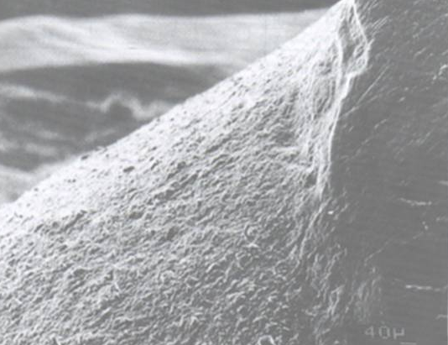
Traditional composites…
1970s.
Amorphous silica & quartz (8-12μm)- 60-70% vol.
Indications

Slide 31
ADVANTAGES | DISADVANTAGES
Compressive, tensile strength Stiffness Hardness Polymerization shrinkage Water sorption, thermal expansion | Polishability Surface roughness Staining, plaque Occlusal wear Poor esthetics

Slide 32
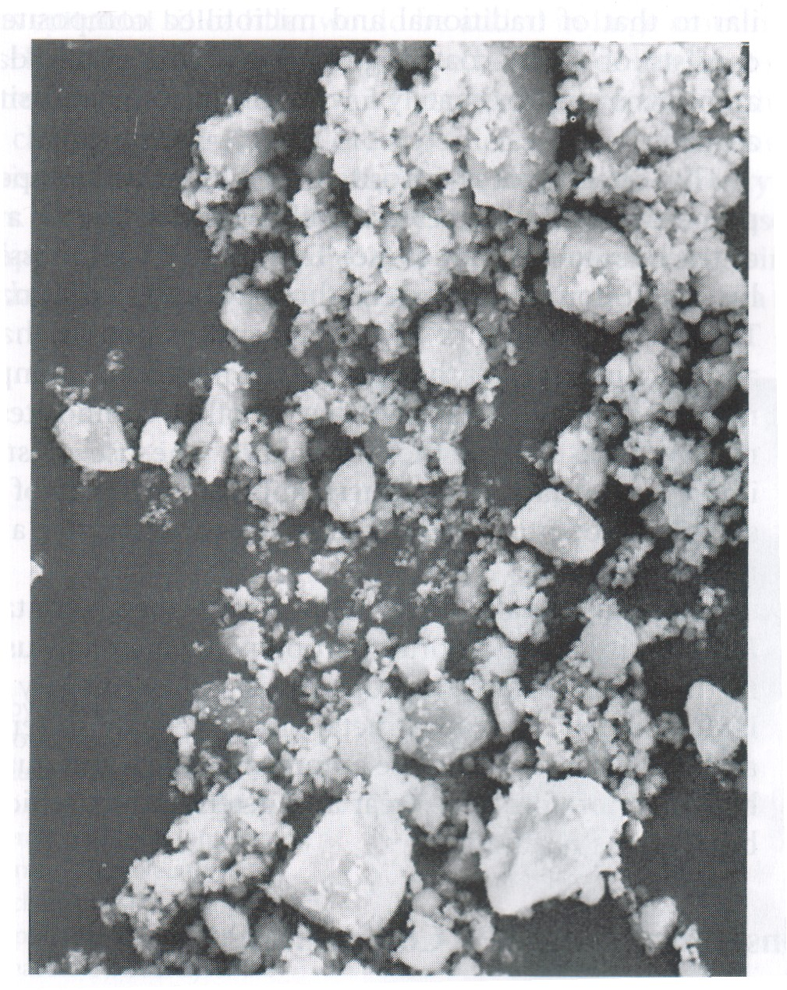
Small particle composites…
Filler size 0.5-3 μm (65-77 % vol)
Glass particle with heavy metals & colloidal silica
Indications

Slide 33
ADVANTAGES | DISADVANTAGES
Good mech properties Good smoothness Wear resistance Less polymerization shrinkage Radioopacity | prone to wear and deterioration.

Slide 34
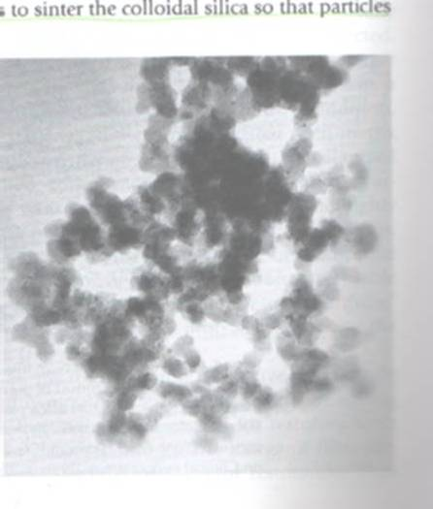
Microfilled composites…
Colloidal silica – 0.04 μm -20-59 % vol
  Agglomerates
  Sintering of colloidal silica
  Prepolymerized composite fillers

Slide 35
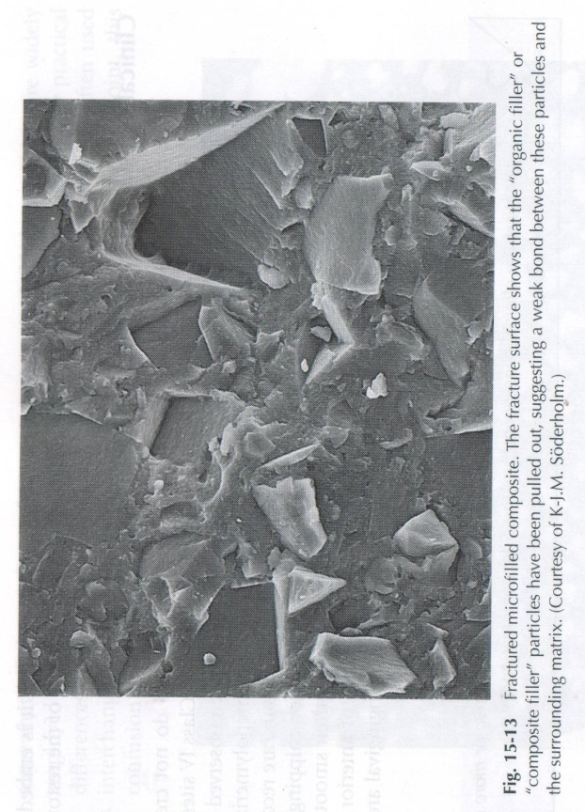
ADVANTAGES | DISADVANTAGES
Best surface finish Excellent wear resistance | Tensile strength Water sorption and CTE fracture resistance Radioluscent Polymerization shrinkage

Slide 36
Hybrid composites…
Fillers
  0.4-1μm – 60-65 % vol
  Colloidal silica (10-20 wt%)
  Glass particles with heavy metals (75-80 wt%)
Intermediate properties
Indications

Slide 37
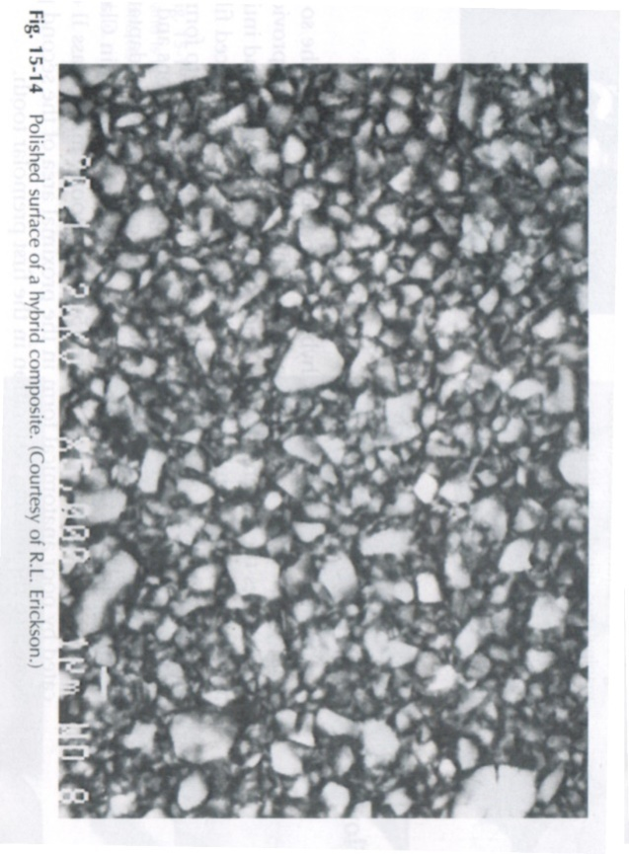
ADVANTAGES | DISADVANTAGES
Good physical properties Improve wear resistance Superior surface morphology Good esthetics | Increased surface roughness with time

Slide 38
CHARACTERISTIC PROPERTY | UNFILLED ACRYLIC | TRADITIONAL | SMALL PARTICLE | HYBRID | MICROFILLED
Size (μm) | - | 8-12 | 0.5-3 | 0.4-1.0 | 0.04-0.4
Inorganic filler (vol%) | 0 | 60-70 | 65-77 | 60-65 | 20-59
Inorganic filler (wt%) | 0 | 70-80 | 80-90 | 75-80 | 35-67
Compressive strength (MPa) | 70 | 250-300 | 350-400 | 300-350 | 250-350
Tensile strength (MPa) | 24 | 50-65 | 75-90 | 40-50 | 30 -50
Elastic modulus (GPa) | 2.4 | 8-15 | 15-20 | 11-15 | 3-6
TEC (ppm/ °C) | 92.8 | 25-35 | 19-26 | 30-40 | 50-60
Water sorption (mg/cm²) | 1.7 | 0.5-0.7 | 0.5-0.6 | 0.5-0.7 | 1.4-1.7
Knoop hardness (KHN) | 15 | 55 | 50-60 | 50-60 | 25-35
Curing shrinkage (vol%) | 8-10 | - | 2-3 | 2-3 | 2-3
Radio opacity(mm\Al) | 0.1 | 2-3 | 2-3 | 2-4 | 0.5-2

Slide 39
 | TRADITIONAL | SMALL PARTICLE | MICROFILLED | HYBRID
Mechanical
Polymerization shrinkage |  |  | x
Polishability | x
Wear resistance
Esthetics | x
Use in posteriors | x |  | x
a

Slide 40
MODE OF SUPPLY…
Basic six systems
    Chemically cured paste-paste
    Chemically cured / Photo cured liquid-powder
    Chemically cured / Photo cured paste – liquid
    Photo cured one paste system
    Photo cured one liquid system
    Chemically cured 3 / 4 part system

Slide 41
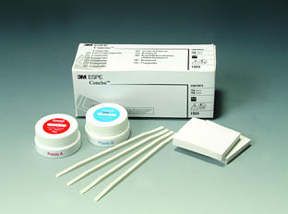
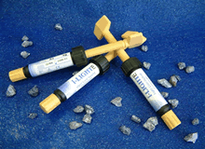
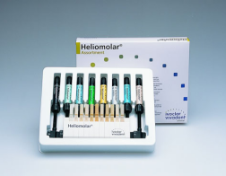
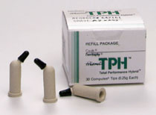
For chemical cure-syringes/tubs
For light cure-spills/syringe/compules

Slide 42
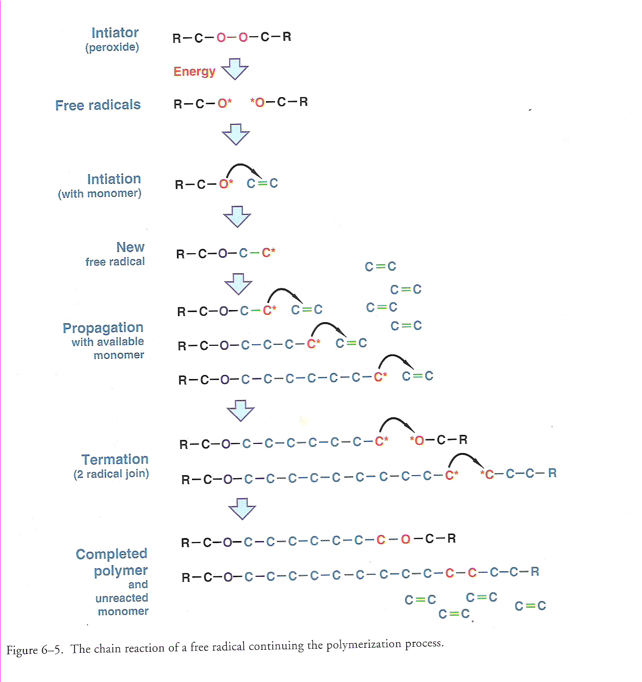
CURING OF COMPOSITES…
POLYMERIZATION

Slide 43
CHEMICAL ACTIVATION
  Chemistry
  Advantages
    Even polymerization-75%
  Disadvantages
    Oxygen inhibition
    Working time

Slide 44
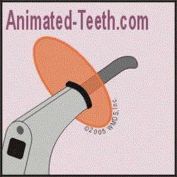
LIGHT ACTIVATION
  UV light
  Visible light
  Advantages
    Easy to use, single paste
    Less porosity
    Less sensitive to oxygen
    Command polymerization
    Colour stability, colors can be optimized
    Better mech properties
    Setting time –faster cure

Slide 45
  Disadvantages
    Increments
    Time consuming
    Poor accessibility
    Variable exposure
    Sensitive to ambient light
    Shrinkage
    Ocular damage
    Cost

Slide 46
Comparison
Chemical | Light cure
Polymerization is central | Peripheral
Curing is one phase | Is in increments
Sets within 45 seconds | Sets only after light activation
No control over working time | Working time under control
Shrinkage towards centre of bulk | Shrinkage towards light source
Air may get incorporated | Less chance of air entrapment
More wastage of material | Less wastage
Not properly finished | Better finish

Slide 47
DUAL CURING
  2 light cure pastes-syringes/tubs
  Chemistry
  Indications
  Disadvantages
EXTRAORAL CURING

Slide 48
CURING LAMPS…
CURING SYSTEMS
UV LIGHT
VISIBLE LIGHT
1970’s-”Nuva Light”
Disadvantages
Types of devices
4 sources of light

Slide 49
TAKE HOME MESSAGE
In late 1960s ,composites were introduced as an alternative to silicates and unfilled resins
Composite refers to a solid formed from two or more distinct phases that have been combined to produce properties superior to or intermediate to those of individual constituent
The first light curing units used UV light to set the material ,later these were replaced by visible light curing systems

Slide 50
QUESTIONS
Describe Techniques of composite placements
Clinical properties of composites
Comparision of chemical and light cure composites

Slide 51
References
Operative Dentistry – MA Marzouk
Art & science of operative Dentistry – Sturdevants (5th edition)
Art & Science of Operative Dentistry – Sturdevants (South Asian Edition)
Textbook Of Operative Dentistry – Vimal K Sikri (1st Edition)
Dental Anatomy, Physiology & Occlusion – Wheeler’s (9th Edition)
Optimizing tooth form with direct posterior composite restorations JCD Oct-Dec 2011 | Vol 14 | Issue 4

Slide 52
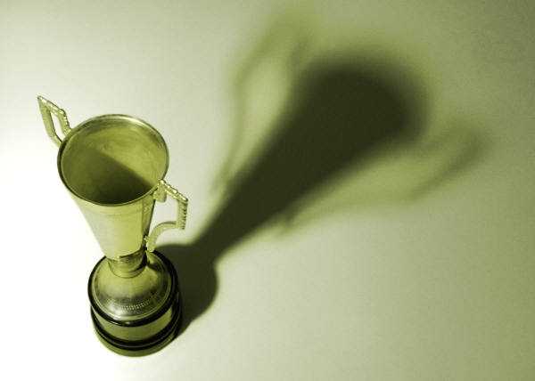
“The world hates change, yet it is the only thing that has brought progress.”
-Charles Kettering
THANK YOU

